Slide 1



THE PREMIUM FARM PLOTS AT RAMNAGAR, JIM CORBETT

Slide 2
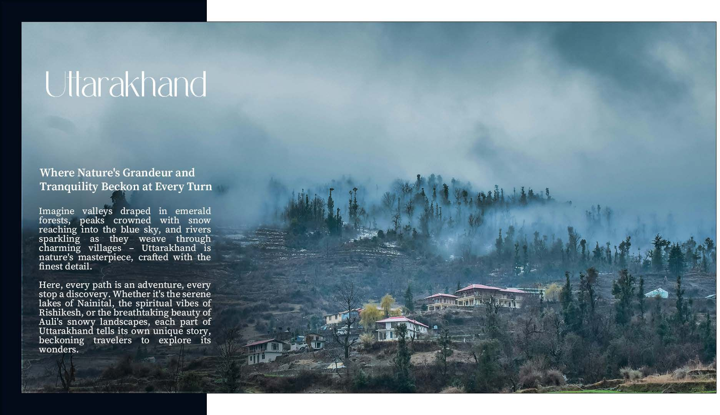

Slide 3


Slide 4

Tourism Growth:
Uttarakhand saw 7 crore tourists in 2023, expected to grow 20%
in 2024 to 8.4 crore.
Economic Impact:
Tourism is vital to Uttarakhand's economy, with the state's GSDP projected at 13.94 trillion (US$ 47.34 billion) in FY24, largely supported by tourism.
Tourism Initiatives:
Focus on eco-tourism, religious circuits, and adventure tourism like trekking and safaris to diversify offerings.
Investment & Development:
Aiming for 120,000 crore in tourism investments by 2030, with plans for 40+ new destinations and capital subsidies infrastructure.
Ramnagar's Role:
Ramnagar, near Jim Corbett National Park, is key to tourism with popular activities like wildlife safaris and bird watching, boosting local hospitality.
Attractions:
In addition to Jim Corbett, Ramnagar's Garjia Temple and Kosi River rafting enhance tourist appeal and economic growth.

Slide 5

Kosi River
Nainital
Bhimtal
Girjya Devi Temple
Kainchi Dham
Jim Corbett Nation Park

Slide 6
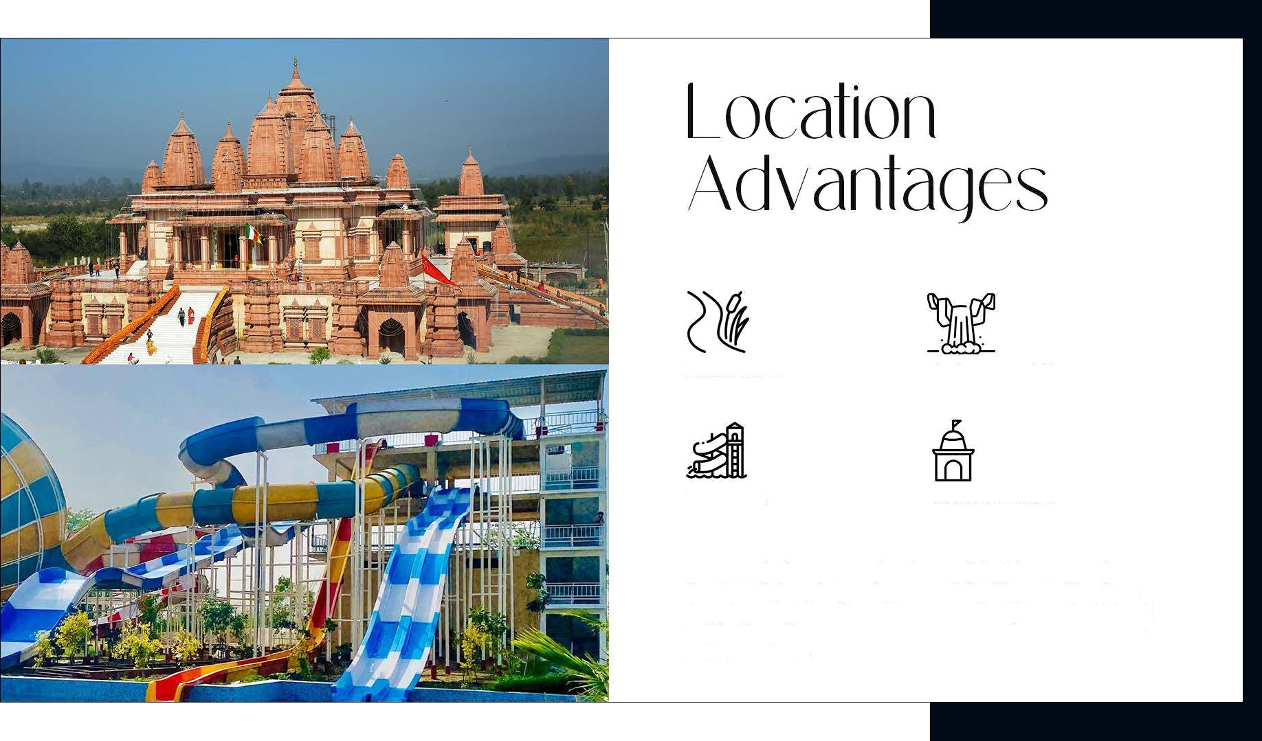
Dhabka River
Corbett waterfall
Waterpark
Hangman Dham
Ramnagar is about 245-260 km from Delhi, with a proposed
four-lane highway improving connectivity. Key amenities like a shopping complex and school are conveniently located within a 5 km radius of the site, making it an ideal location for accessibility and convenience.

Slide 7
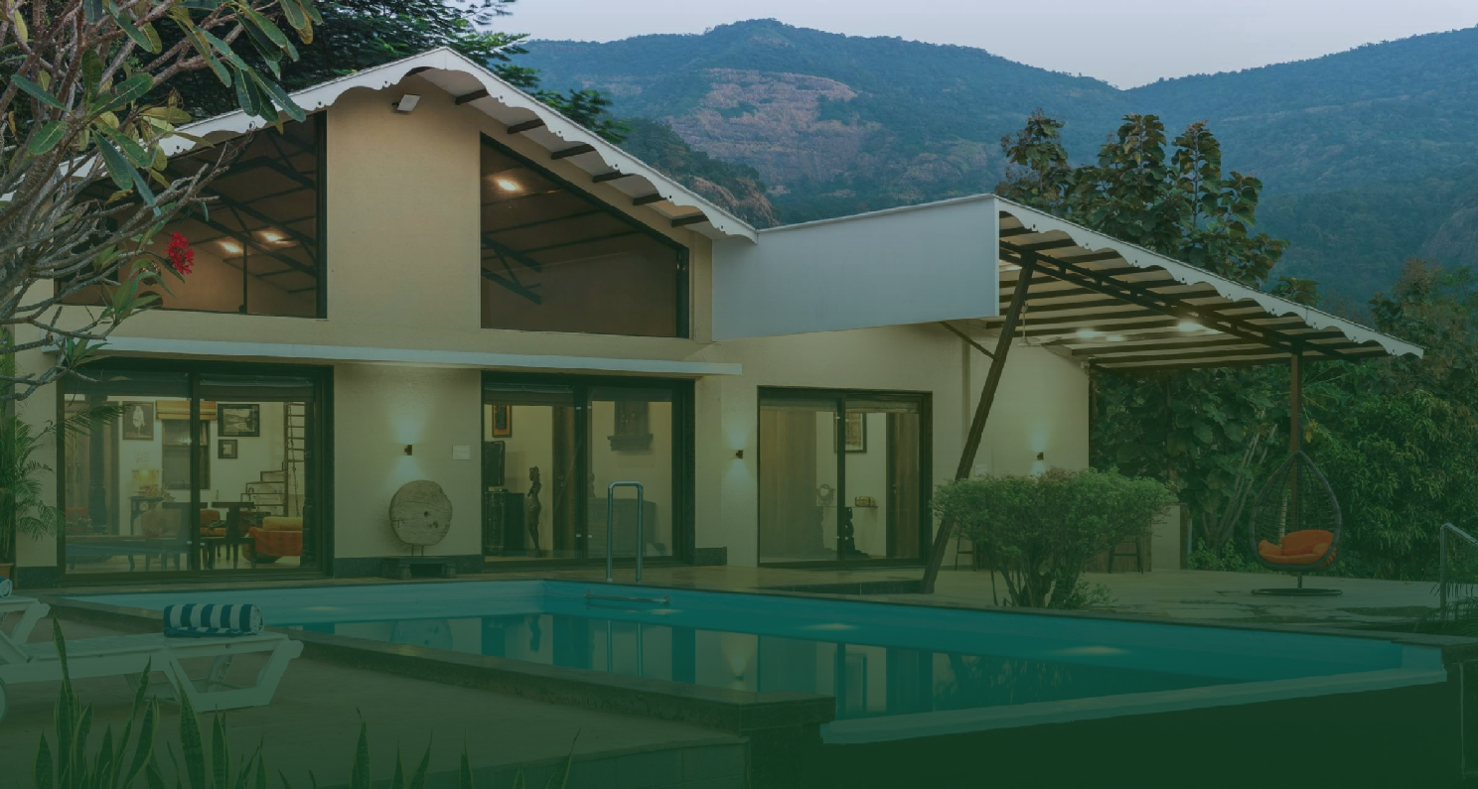
Welcome to Corbett
THE PREMIUM FARM PLOTS AT RAMNAGAR, JIM CORBETT

Slide 8
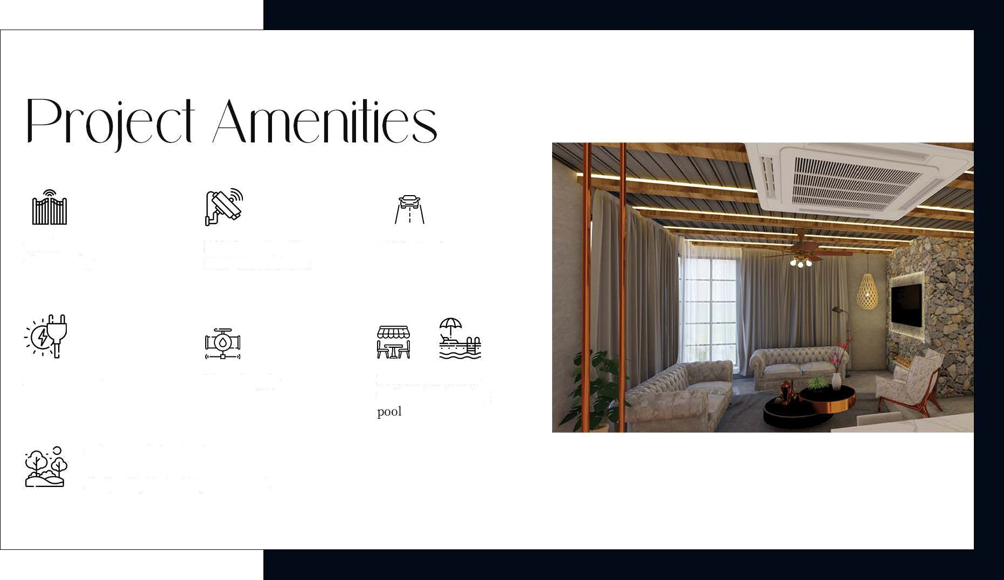
Gated
Community
24*7 Security with
CCTV Surveillance
Wide Roads
Power Supply
Water Supply
Dedicated area for Cafe and Swimming
Only Peaceful and calm environment
Air Quality Index 25 year around.

Slide 9
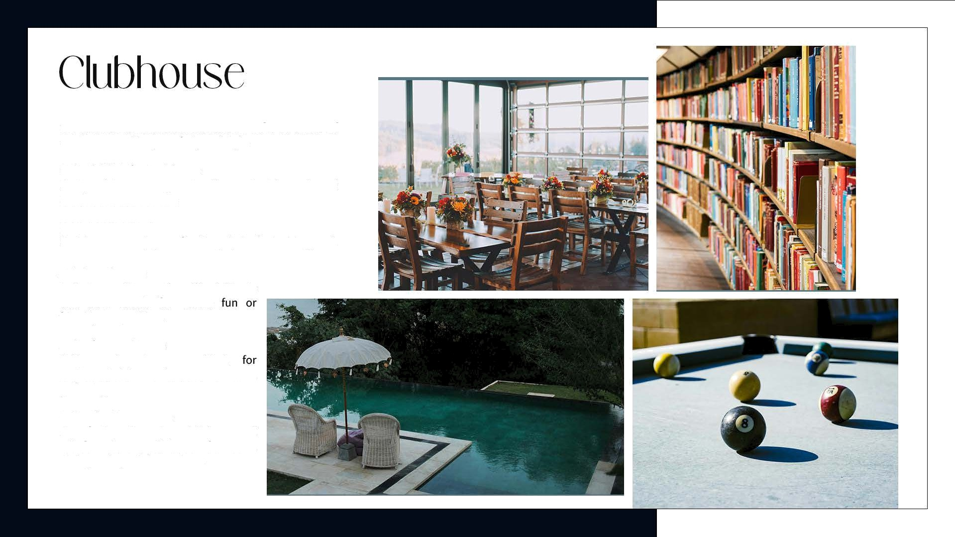
Exclusive Residential Clubhouse: Offers a blend of modern amenities, comfort, and style.
Social Hub for Residents:
Designed to encourage relaxation, entertainment, and community interaction.
Swimming Pool:
Residents can enjoy a refreshing dip in the inviting pool.
Indoor Games:
Includes exciting options like billiards and table tennis for casual
friendly competition.
Conference Room:
Fully equipped space
needs,
ideal
meetings, business gatherings.
or social
6. On-Site Restaurant:
A perfect spot to enjoy a delicious meal or refreshing drinks, suitable for casual dining and special occasions.

Slide 10
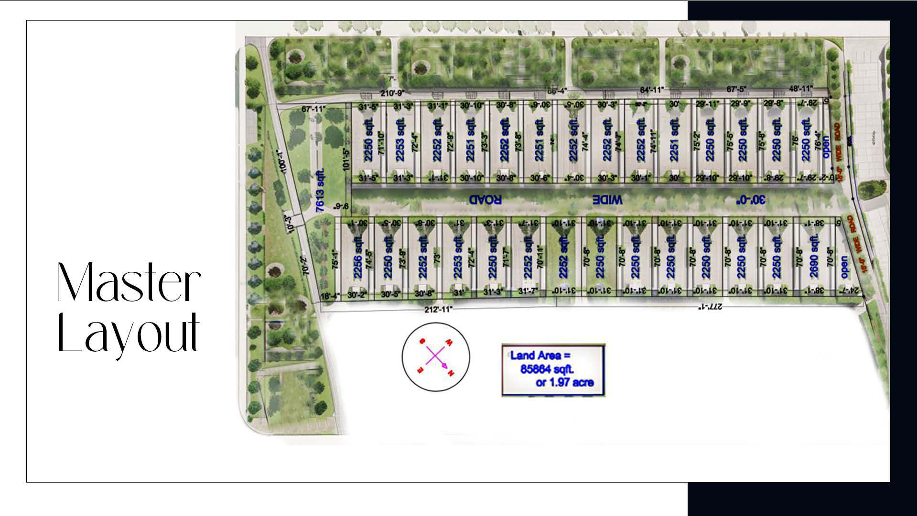

Slide 11
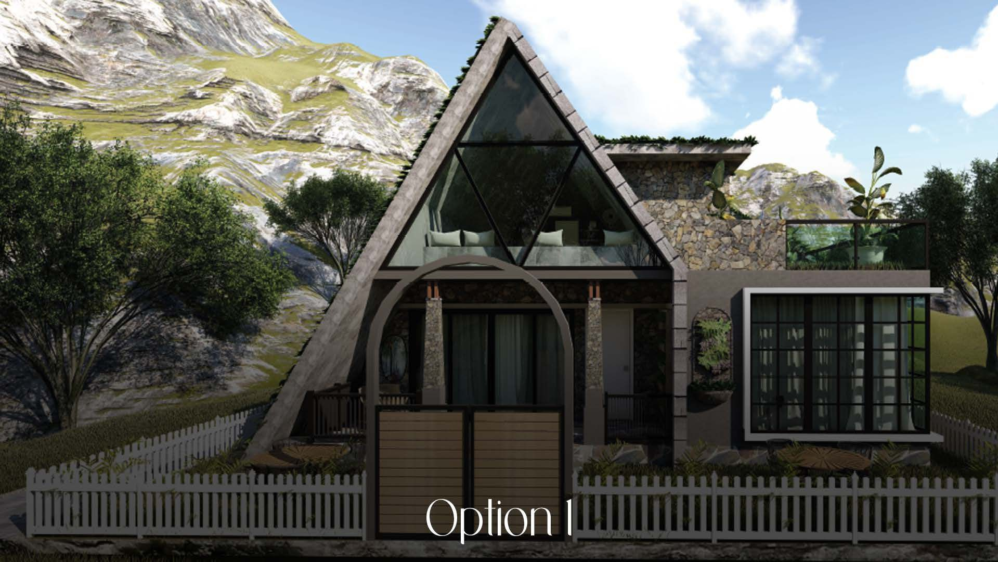

Slide 12
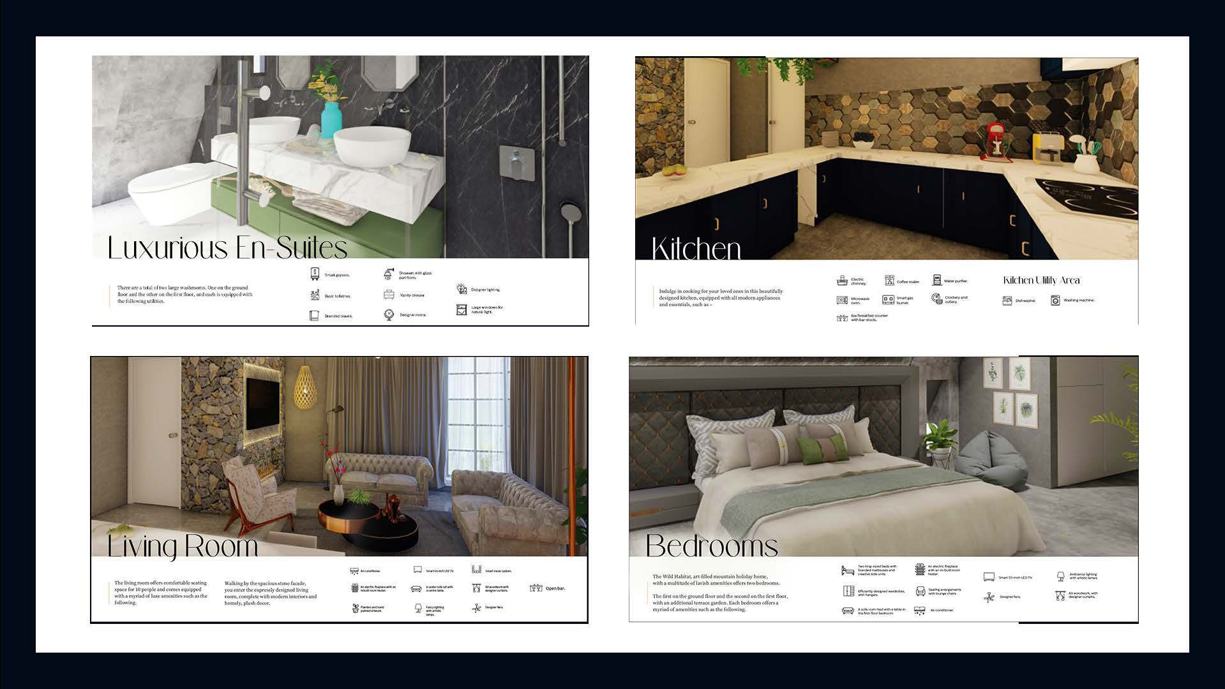

Slide 13
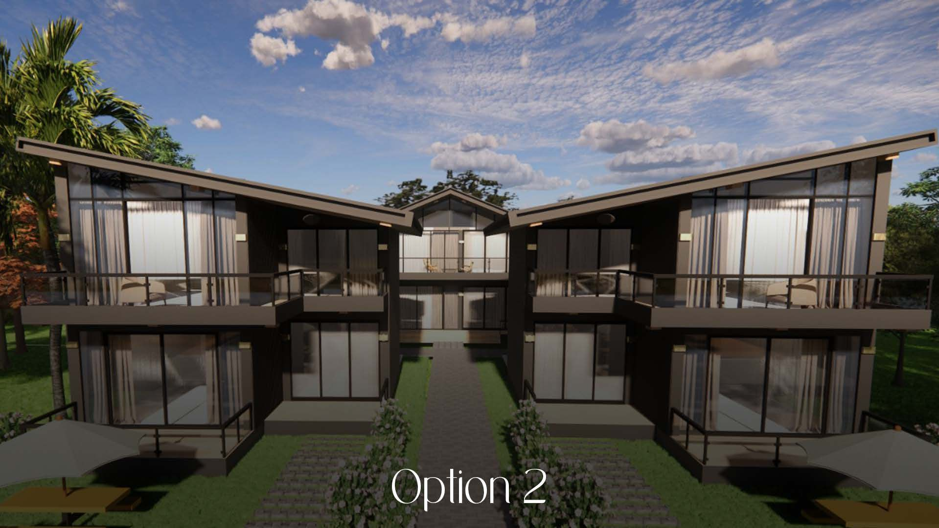

Slide 14
Beú c

Slide 15

Corporate Office: C56/10, Sector 62, Noida,
Uttar Pradesh 201301
For more Information visit:
CorbettQkeZ
www.mysticmansionrealty.com

